Slide 1
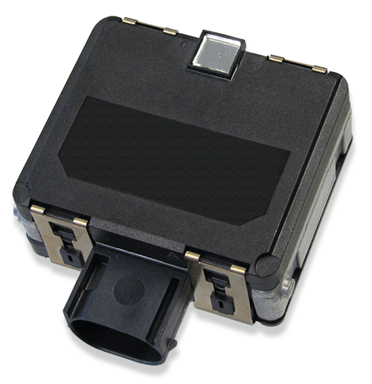
BOSCH RADAR
Description
The BOSCH CAS-M Light is a compact, mid-range radar sensor designed for advanced driver assistance systems (ADAS) and autonomous driving.
It provides reliable object detection, even in adverse weather and low-visibility conditions, offering range and angle measurements.
Specifications
Operating Voltage - 6.5V to 18V
Detection Range - 150m
Operating Temperature : -40ºC to +85ºC
CAM Rate - 500k baud to 1M baud
Applications
Adaptive Cruise Control
Collision Avoidance
Emergency Braking Systems
Autonomous Driving
Official Website :
https://www.bosch-motorsport.com/content/downloads/Raceparts/en-GB/66057227112386571.html

